Slide 1

PYTHON SOFTWARE PROJECT
Library Management System
An object-oriented console application demonstrating encapsulation, abstraction, inheritance, polymorphism, and core Python engineering practices.
main.py • library.py • models.py • file_handler.py

Slide 2





Project Overview
A menu-driven console app for managing a book catalog, members, and borrow/return transactions.
Catalog Management
Issue & Return
Member Records
Add, update, remove, and search books and eBooks in the library catalog.
Track borrowing with due dates, automatic fine calculation for late returns.
Each member keeps an encapsulated, immutable snapshot of borrowed titles.
Reporting
Persistence
Robust Error Handling
Low-stock alerts, category breakdowns, and outstanding fines summaries.
Catalog state and transaction history are saved to JSON and log files.
Custom exceptions catch invalid operations before they corrupt data.

Slide 3



System Architecture
Four modules, each with a single, clear responsibility.
main.py
Console menu loop, user I/O, input validation, and top-level exception handling.
library.py
Library class — orchestrates the catalog, members, search, and reporting logic.
models.py
Domain classes — LibraryItem (abstract), Book, EBook, Member, Transaction.
file_handler.py
Reads/writes the JSON catalog and the plain-text transaction log to disk.
Data flow: main.py → library.py → models.py / file_handler.py

Slide 4



Object-Oriented Design
All four pillars of OOP are used deliberately in models.py.
Encapsulation
Abstraction
Inheritance
Polymorphism
Private attributes (_title, _copies) exposed only through validated properties.
LibraryItem is an ABC — it hides implementation detail behind get_details().
Book and EBook inherit shared behavior from LibraryItem / Book.
Book vs. EBook run different code for the same is_available() call.

Slide 5
Encapsulation
Bundling data with the logic that protects it — and hiding the rest.
Attributes like _title and _copies use a leading underscore to signal “internal use only.”
Read access goes through @property getters (title, category, copies).
Writes go through a @copies.setter that validates before mutating state.
Member._borrowed_books stays private; borrowed_books returns an immutable tuple copy.
models.py
class Book(LibraryItem):
def __init__(self, title,
category, copies):
super().__init__(title,
category)
self._copies = copies
@copies.setter
def copies(self, value):
if value < 0:
raise ValueError(
"Copies cannot
be negative")
self._copies = value

Slide 6
Abstraction
Exposing what an object does, while hiding how it does it.
LibraryItem extends Python's ABC and can never be instantiated directly.
get_details() is marked @abstractmethod — every subclass must supply its own version.
Calling code (main.py) just calls book.get_details() without knowing whether it's a Book or an EBook.
This keeps the menu logic in main.py simple and decoupled from catalog internals.
models.py
class LibraryItem(ABC):
@abstractmethod
def get_details(self):
"""Subclasses MUST
override this."""
raise NotImplementedError
# LibraryItem(...) -> TypeError
# Book/EBook can be created;
# each defines its own
# get_details() body.

Slide 7





Additional Python Concepts
Beyond OOP, the project showcases a broad slice of core Python.
Exception Handling
File Handling
Functional Programming
Custom errors (BookNotFoundError, BookUnavailableError) plus try/except/finally in file I/O.
JSON catalog persistence and append-mode transaction logging via context managers (with).
map(), filter(), lambda, sorted(key=...), and list/set/dict comprehensions throughout library.py.
Generators
Data Structures
Variable Scope
low_stock_report() uses yield to stream results without building an intermediate list.
Dicts, lists, tuples, and sets each chosen deliberately — e.g. tuples for immutable snapshots.
main.py demonstrates global vs. local scope with the total_actions counter.

Slide 8


System Requirements
What's needed to run and maintain the application.
Hardware & Software
Functional & Non-Functional
Python 3.8+ (uses dataclass-free ABC & typing-friendly syntax)
Standard library only — no external pip packages required
Any OS: Windows, macOS, or Linux with a terminal
Minimum 1 GB RAM, < 10 MB disk space for code + data files
Write access to a local /data directory (JSON + log files)
Text editor or IDE (VS Code, PyCharm) for development
Add, update, remove, search, and list catalog items
Issue and return books with automatic overdue fines
Persist catalog and transactions across restarts
Reliability: validated inputs reject negative copy counts
Usability: numbered menu, clear error messages
Maintainability: single-responsibility modules, ABC-enforced contracts

Slide 9
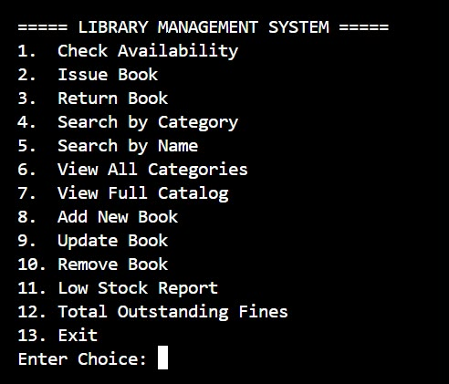
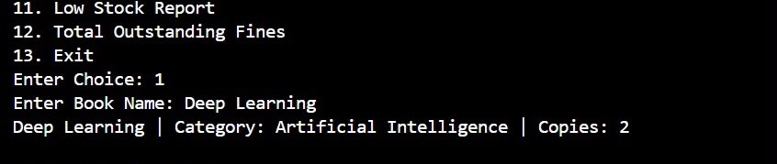

Output
Sample runs of the console application.
Main Menu
Check Availability
Search — Book Not Found

Slide 10

Conclusion & Next Steps
The system demonstrates a clean, well-encapsulated OOP design that is easy to extend.
01
02
03
04
Graphical UI
Database Backend
Authentication
Unit Tests
Wrap Library in a Flask or Tkinter front end.
Swap JSON persistence for SQLite/PostgreSQL.
Add librarian vs. member login roles.
Cover Library, models, and file_handler with pytest.
Thank you

